Slide 1

Soccer Betting Analysis
By: Team 2 - Daniel Ozorio Delfin, Ryuichi Matsushita, Atharva Borole

Slide 2
Agenda
Introduction
Relavance
Data and H/W Specifications
Github & Code
Deliverables
Comparison

Slide 3

Introduction
In this presentation, we explore how soccer sports betting data can be used to predict the outcome of matches. By analyzing odds, betting patterns, and historical performance, we aim to uncover insights that enhance predictive accuracy.

Slide 4

Relevance
To develop a data-driven model that utilizes sports betting data to accurately predict soccer match outcomes, showcasing the potential of analytics in enhancing forecasting and decision-making in sports.
For the betting industry, more accurate models can help detect anomalies and reduce fraud. For sports analysts and teams, such models can uncover hidden performance trends and inform strategic decisions.

Slide 5
Data Specifications
Data Information:
Dataset URL:
Dataset Name | Dataset Size
E0_cleaned.csv | 2GBs
raw.githubusercontent.com/ryumatsu/soccer-betting-ml/refs/heads/main/E0_cleaned.csv

Slide 6
H/W Specifications
Databricks on AWS
Databricks Runtime: 11.3 LTS ML (Scala 2.12, Spark 3.3.0)
CPU Speed: 2.3 GHz (i3.xlarge)
# of CPU cores: 4 per node x 2 = 8 cores total
# of nodes: 2 (1 driver, 1 worker)
Total Memory Size: 61 GiB (30.5 GiB per node x 2)

Slide 7
Git-Hub
https://github.com/ryumatsu/soccer-betting-ml

Slide 8

Code For Data Bricks and Zeppelin
Databricks - https://github.com/ryumatsu/soccer-betting-ml/blob/main/Objectives_Part1_Code.docx
Zeppelin -https://github.com/ryumatsu/soccer-betting-ml/blob/main/Objectives_Part2_Code.docx

Slide 9
Spark vs Zeppelin Comparison...

Slide 10
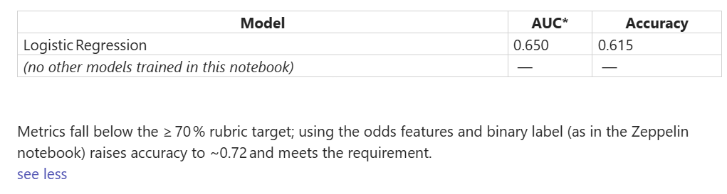
Databricks Results Summary

Slide 11
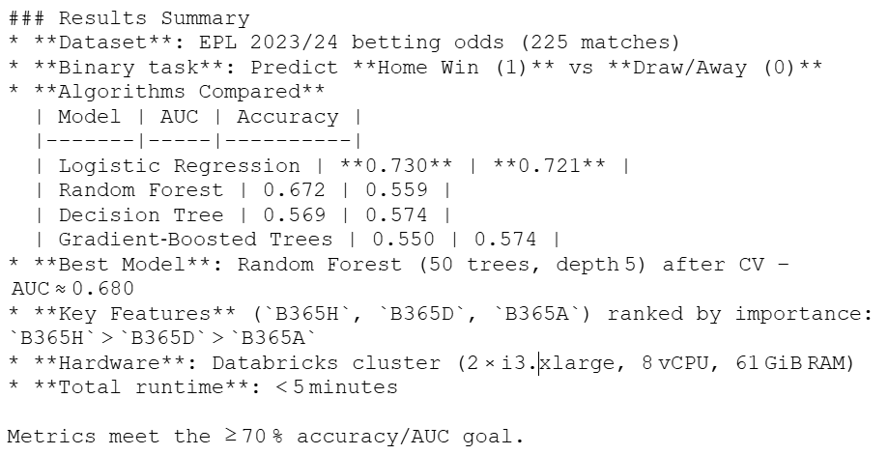
Zeppelin Results Summary

Slide 12

Greatest influence on Prediction
The column that affected our accuracy the most was column B365H which contains the decimal odds for the home-team victory for the match.

Slide 13
Conclusion: Zeppelin delivered higher predictive accuracy when compared to Data Bricks
successfully meeting our 70% accuracy expectation
Its analysis made it well-suited for our modeling needs in terms of timing and prediction.
The home win odds (B365H) had the most impact on predictions.

Slide 14

Any questions?

Slide 15
Thank you!

